Slide 1

DISPARITIES IN VICTIMIZATION RATES AMONG ASIAN AND BLACK IN THE CITY OF LOS ANGELES DURING THE COVID PANDEMIC
EPPS 6356 Data Visualization
Farrah Ali, Hoda Elsafadi, Grant Powell, Tayaba Saleem, Yichao Jin
Fall 2023

Slide 2
TABLE OF CONTENTS
1
TOPIC OVERVIEW
5
RESULTS
2
LITERATURE REVIEW
6
DISCUSSION
3
HYPOTHESES
7
CONCLUSION
4
METHODOLOGY
8
SHINY APP DEMO

Slide 3

TOPIC OVERVIEW
DISPARITIES IN VICTIMIZATION RATES AMONG ASIAN AND BLACK IN THE CITY OF LOS ANGELES DURING THE COVID PANDEMIC.
The objective of our research is to graphically demonstrate victimization rates of Asian and Black Americans in the city of Los Angeles from 2020-2022. This will allow us to understand the impact of the COVID pandemic as well as political and social shifts on victimization rates among these groups.

Slide 4

LITERATURE REVIEW
Victimization of Asian Americans
There was a reported increase in hate crimes against Asian-Americans and people of Asian descent during the t COVID pandemic. Researchers such as Smith (2020) noted a surge in incidents like verbal harassment, physical assaults, and vandalism specifically directed at individuals of Asian descent.
.

Slide 5

LITERATURE REVIEW
Victimization of Black Americans
African Americans have been disproportionately affected by hate crimes, a consequence of systemic racism and historical injustices (Smith, 2020). Racial profiling, economic disparities, and a legacy of historical injustices contribute to an environment where hate crimes against this community persist.

Slide 6

HYPOTHESIS
Ha #1: Over time we will see an increase in the victimization rates of Asian Americans in Los Angeles from 2020-2021.
Ha #2: Over time we will see an increase in the victimization rates of Black Americans in Los Angeles from 2020-2021.

Slide 7

METHODOLOGY
We will be utilizing secondary data on crime in Los Angeles from 2020 to the present from Data.gov. We will assess the relationship between Asian and Black race and their victimization rate throughout the COVID pandemic and civil unrest that occurred in 2020.

Slide 8
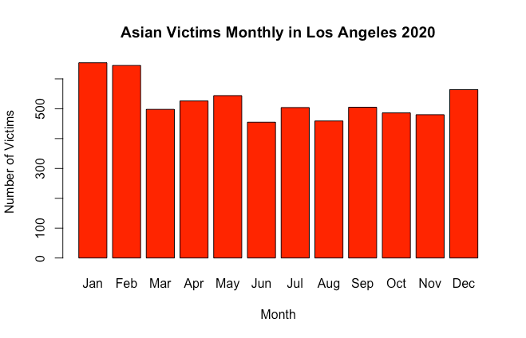
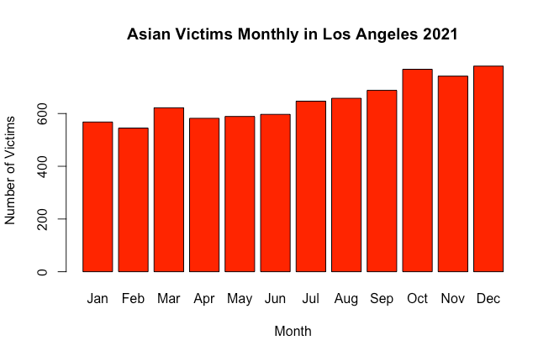
RESULTS
DATA VISUALIZATION OF ASIAN AMERICAN VICTIMIZATION FROM 2020-2021
2020
2021

Slide 9
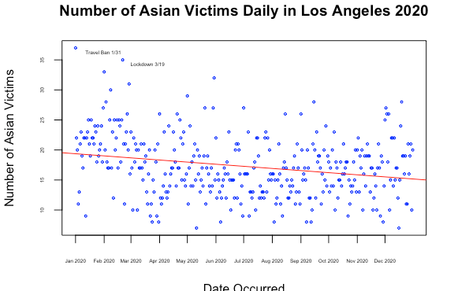
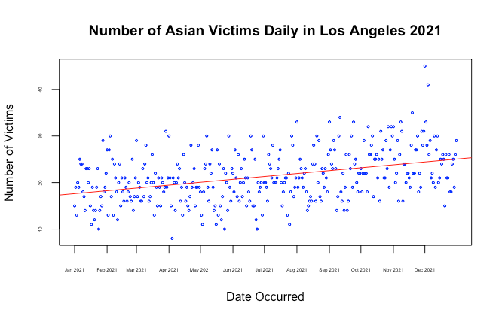
RESULTS
DATA VISUALIZATION OF ASIAN AMERICAN VICTIMIZATION FROM 2020-2021
2020
2021

Slide 10
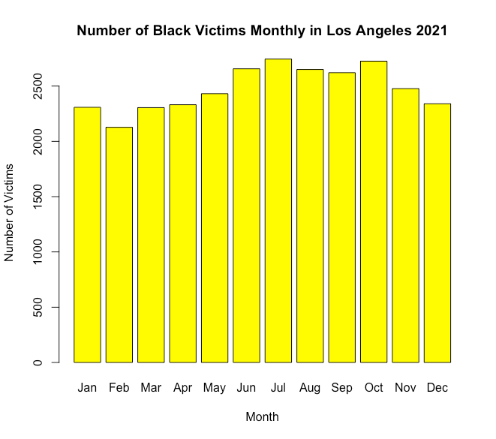
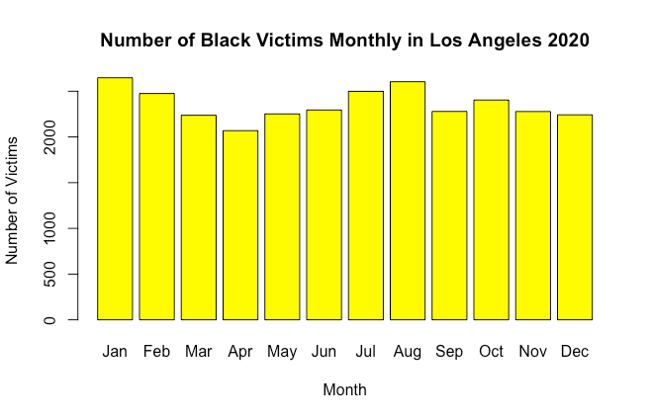
RESULTS
DATA VISUALIZATION OF BLACK AMERICAN VICTIMIZATION FROM 2020-2021

Slide 11
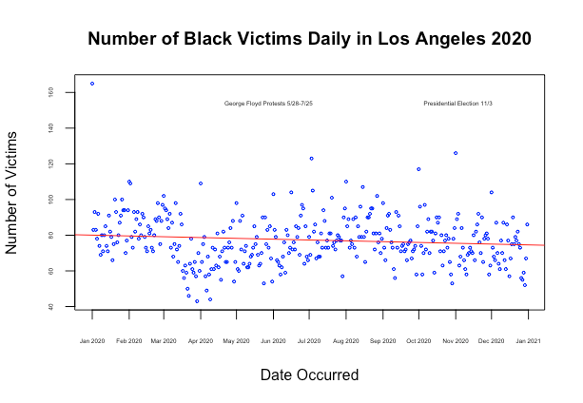
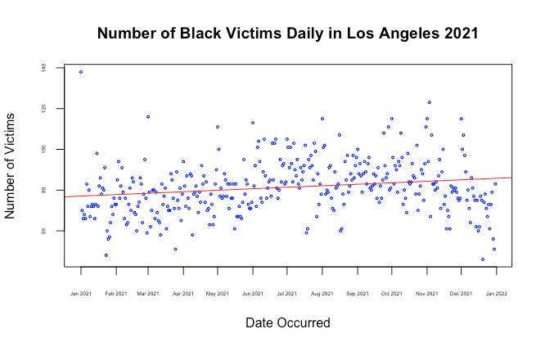
RESULTS
DATA VISUALIZATION OF BLACK AMERICAN VICTIMIZATION FROM 2020-2021
2020
2021

Slide 12
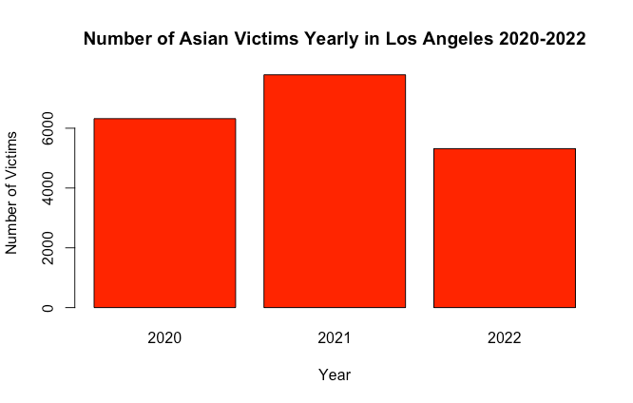
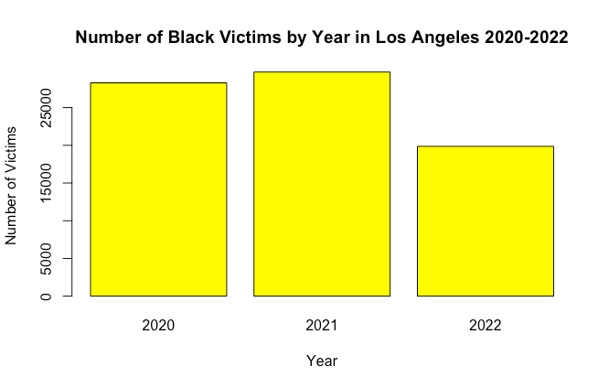
RESULTS
DATA VISUALIZATION COMPARING THE VICTIMIZATION OF ASIAN AMERICANS & BLACK AMERICANS FROM 2020-2022

Slide 13
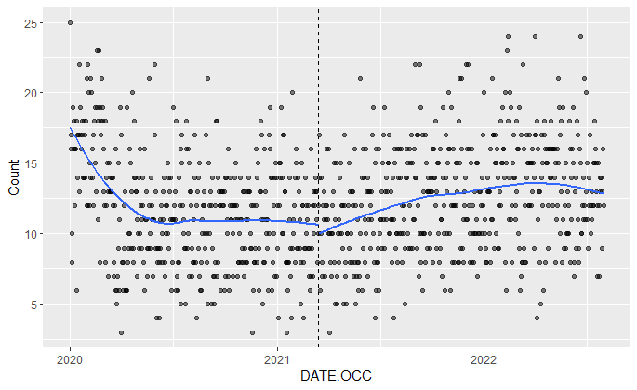
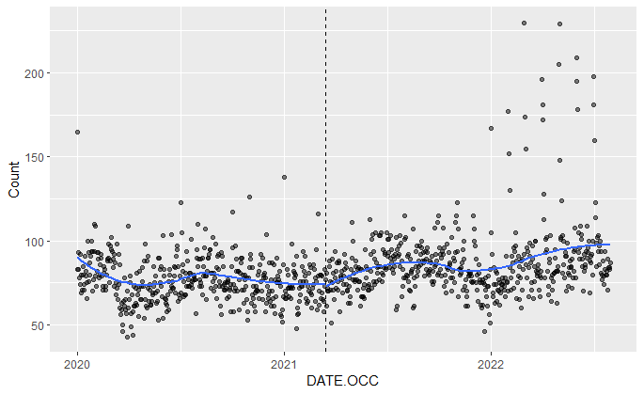
RESULTS
DATA VISUALIZATION COMPARING THE VICTIMIZATION OF ASIAN AMERICANS & BLACK AMERICANS FROM 2020-2022
TIME SERIES PLOT WITH DISCONTINUITY DESIGN FOR THE ASIAN VICTIMS
TIME SERIES PLOT WITH DISCONTINUITY DESIGN FOR THE BLACK VICTIMS

Slide 14

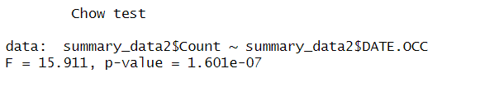
RESULTS
CHOW TEST
TIME SERIES PLOT WITH DISCONTINUITY DESIGN FOR THE ASIAN VICTIMS
TIME SERIES PLOT WITH DISCONTINUITY DESIGN FOR THE BLACK VICTIMS

Slide 15

CONCLUSION
The hate crimes against Asian Americans during the COVID-19 pandemic, alongside the pivotal events of 2020, including the 2020 U.S. Presidential Election and the Black Lives Matter (BLM) protests, have each left a distinctive mark on the American societal landscape.
According to the data visualization analysis, from 2020 to 2022 there was a slight discontinuity in hate crimes against Asian Americans in the city of Los Angeles before and after a certain time point. Still, the regression line of black hate crime almost remained consistent. However, the Chow test rest shows both groups suffered a significant change in victim rate, We fail to reject both hypothesis#1, and hypothesis#2

Slide 16

SHINY APP DEMO

Slide 17
WORKS CITED
SMITH, D. (2020). THE BLACK LIVES MATTER MOVEMENT AND ITS IMPACT ON POLICING AND POLICY
CHANGES. JOURNAL OF PUBLIC POLICY AND SOCIAL CHANGE, 25(1), 12-30.

